Slide 1
Examples of animations made with FirstGlance in Jmol
The following animations were made easily from the Save Animation dialog, as illustrated at the end of this presentation.
2021 FirstGlance.Jmol.Org
- Eric Martz

Slide 2
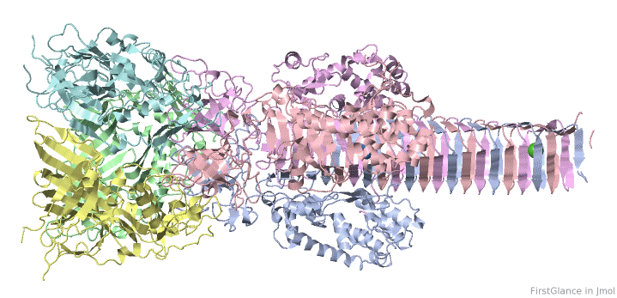
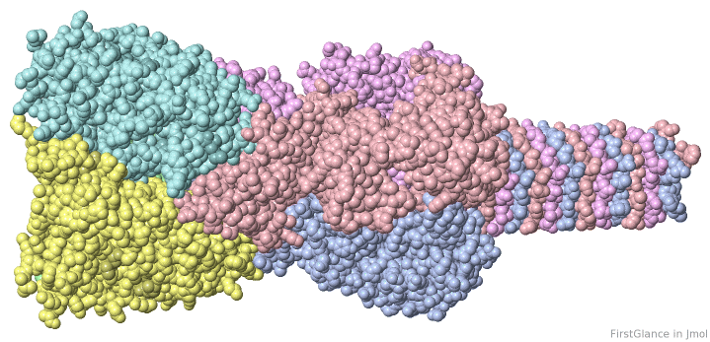
Bacteriophage T4 cell-puncturing protein (biological unit of 1k28)
Each of the 6 chains is given a different color.
Version 4 of FirstGlance automatically constructs and shows biological unit 1. Here, it contains 3 copies of the asymmetric unit.
2022 FirstGlance.Jmol.Org

Slide 3
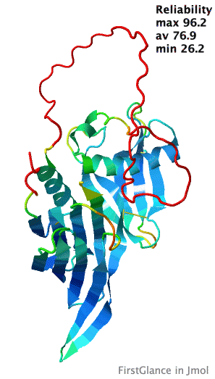
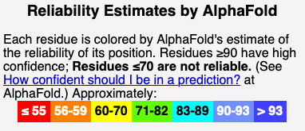
AlphaFold has proven remarkable success in accurate predictions of protein structures from sequences. FirstGlance automatically colors such predictions by the reliabilities estimated by AlphaFold.
See How to predict structures with AlphaFold.
2022 FirstGlance.Jmol.Org
with AlphaFold.

Slide 4
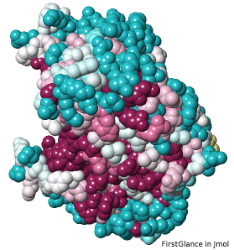
Enolase, an enzyme in glycolysis (4enl), showing evolutionary conservation of the catalytic pocket.
2021 FirstGlance.Jmol.Org
with ConSurf (Tel-Aviv University, Israel)

Slide 5
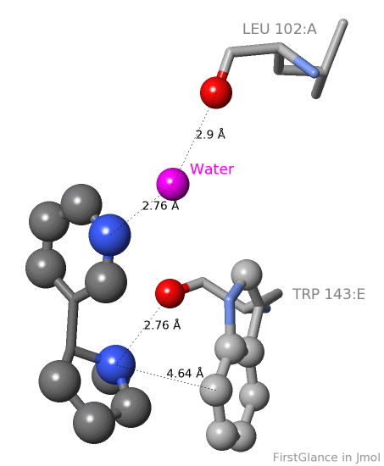
Nicotine bound to protein receptor (1uw6).
Top: Water bridge from N in nicotine to main chain O of Leu102.
Bottom: Cation-pi interaction (N in nicotine 4.59 Å from aromatic ring in Trp143), critical in nicotine addiction, responsible for millions of deaths annually.
Nicotine
2021 FirstGlance.Jmol.Org
using Tools, Contacts and Non-Covalent Interactions.

Slide 6
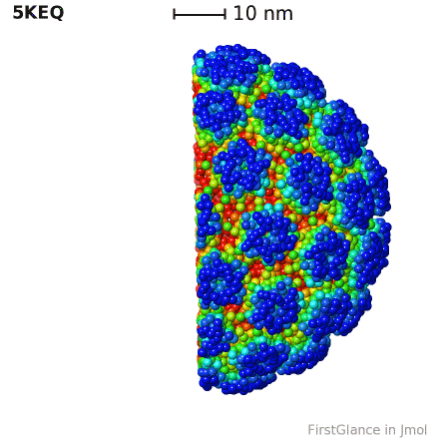
100 Å
Human Papilloma Virus half-capsid:
Biological Unit 1 of 5keq.
Colored by distance from the center.
Version 4 of FirstGlance automatically constructs and colors biological unit 1. Here, it contains 60 copies (360 chains) of the 6 chains in the asymmetric unit.
Large assemblies are automatically simplified by FirstGlance to improve visualization performance. Here, only every 7th alpha carbon is shown.
Version 4 shows a scale bar that resizes with zooming.
2022 FirstGlance.Jmol.Org

Slide 7
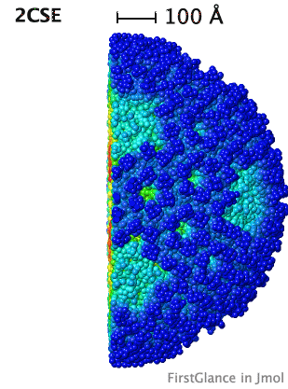
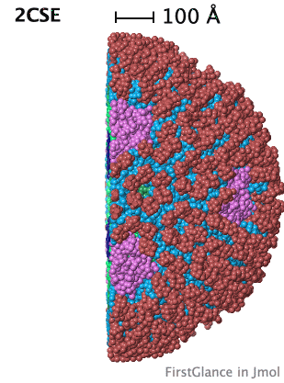
Reovirus half-capsid
Colored by distance from center.
Each of 6 sequence-distinct proteins has a unique color.
Color schemes are applied with 1-click buttons in the Solid View.
Capsid is 112 MDa, diameter ~830 Å, thickness 165-225 Å, 1,620 chains, ~15 million atoms including hydrogen. Here: automatically simplified from ~1 million alpha carbons to only every 10th.
2022 FirstGlance.Jmol.Org

Slide 8
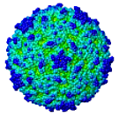
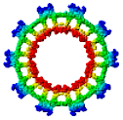
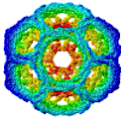
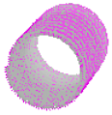
Click This Link To See How To
Visualize and Measure These
Large Assemblies in FirstGlance in Jmol
Polio Eastern Clathrin Vault Gas
Equine Coat Eukaryotic Vesicle
Encephalitis Nanocompartment
2022 FirstGlance.Jmol.Org

Slide 9
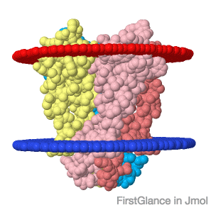
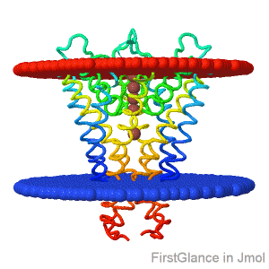
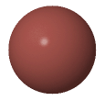
Potassium channel (1r3j) showing boundaries of lipid bilayer.
Outside boundary of lipid bilayer.
Inside boundary of lipid bilayer.
Potassium ion.
2021 FirstGlance.Jmol.Org
with Orientations of Proteins in Membranes (Univ. Mich.)

Slide 10
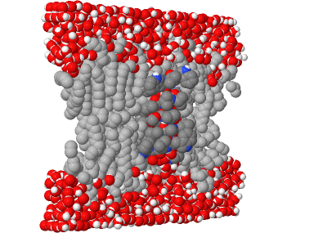
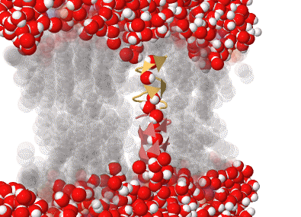
Gramicidin channel in lipid bilayer (theoretical model*).
Lipid bilayer with gramicidin peptides surrounded by water.
Water occupying channel in gramicidin peptides embedded in lipid bilayer.
*Crouzy et al., Biophys. J. 67:1370, 1994.
2021 FirstGlance.Jmol.Org
capturing customized scene from Proteopedia.Org (Method: Note A.)

Slide 11
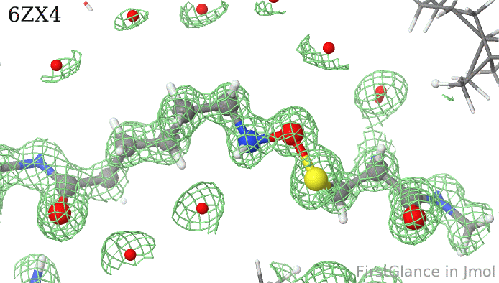
Lysine-Cysteine “NOS” Protein Crosslinks, I.
Lys-Cys NOS bonds were first reported in 2021. They form covalent crosslinks between the sidechains of lysine and cysteine.
Here is the electron density map of the Lys-Cys bond in 6zx4, determined by X-ray diffraction with resolution 1.0 Å.
FirstGlance version 3.5, released in August, 2021, makes it easy to see density maps for X-ray models as well as Electron Microscopy models. It also automatically detects NOS bonds as well as 6 other types of covalent protein crosslinks, such as isopeptide bonds.
2021 FirstGlance.Jmol.Org

Slide 12
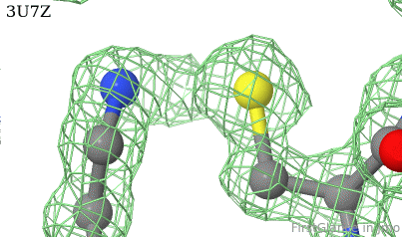
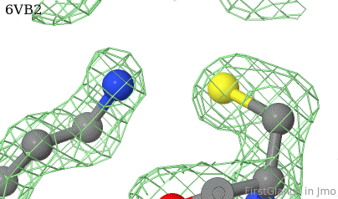
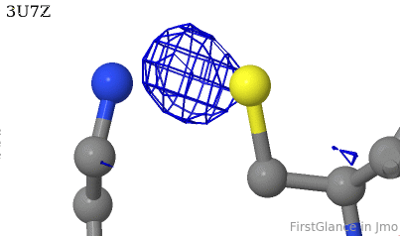
Lysine-Cysteine “NOS” Protein Crosslinks, II.
In protein structures determined before 2021, NOS crosslinks, when present, would usually have been overlooked. This appears to be the case for 3U7Z (2011).
In contrast, the density map for a similarly close Lys-Cys pair in 6VB2 (resolution 1.4 Å) rules out a missing oxygen atom.
The difference map for 3U7Z (resolution 1.3 Å) shows density for a missing atom, presumably oxygen.
2021 FirstGlance.Jmol.Org

Slide 13
End of demonstration examples.
Slides beyond this point provide technical information about the methods employed in the previous slides.
2021 FirstGlance.Jmol.Org

Slide 14
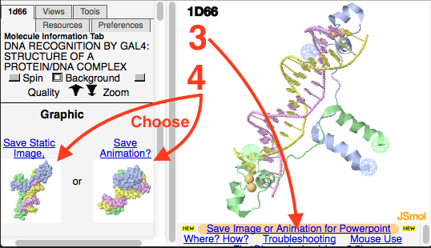
Methods for Generating Animations in FirstGlance. I.
Display the molecular model of interest in FirstGlance in Jmol:
Enter a PDB code or
Upload a PDB file from your computer or
Specify the URL of a model online.
Render and color the model as desired using the many options in FirstGlance.
Click on Save Image or Animation for Powerpoint.
Click Save Animation.
Follow instructions in the lower left panel of FirstGlance.
Drag the saved GIF file and drop it into a slide in your presentation software (Powerpoint, Google Slides, Libre Office).
2021 FirstGlance.Jmol.Org

Slide 15
Methods for Generating Animations in FirstGlance. II.
Some of the animations shown here used models (PDB files) generated by resources outside of FirstGlance. These resources are all available from links in the Resources tab within FirstGlance, including:
AlphaFold: How to predict structures from sequences.
ConSurf server to color by evolutionary conservation.
Orientations of Proteins in Membranes server for seeing boundaries of lipid bilayers.
Proteopedia.Org for customized molecular scenes. See Note A, next slide.
As well as
Practical Guide to Homology Modeling (also explains how to find empirical models).
Predict intrinsically disordered regions of protein chains.
Evaluate model quality, including atomic clashes (MolProbity server).
2022 FirstGlance.Jmol.Org

Slide 16
Methods for Generating Animations in FirstGlance. III.
FirstGlance can be used to animate molecular scenes from Proteopedia.Org. Unlike FirstGlance, Proteopedia enables you to easily customize the rendering and coloring. Instructions.
2021 FirstGlance.Jmol.Org

Slide 17
The End
2021 FirstGlance.Jmol.Org

